Slide 1
About this template:
Purpose
This presentation is intended to inform collegiate staff responsible for advising student-athletes and institution colleagues (coaches, advisors, etc.) on the two-year college transfer requirements.
Use this presentation when sharing the requirements with groups, or in one-on-one situations as appropriate.
Customization
This presentation is branded with NCAA logos and color schemes. Customize the content and images as appropriate for your institution.
Using this slide deck
Content on each slide is intended to reinforce the must-have key points (it’s not a script).
Specific facilitator notes are located in the Notes Page View of this document. View and/or print the Notes Page View of this file to see all the relevant content.
Notes:
See slide for information on using this template.
About this template
1 slide

Slide 2
Two-Year College Transfer Requirements
<Insert Date Here>
Notes:
Welcome colleagues to the session.
Lead the group in introductions (if necessary).
<INSERT INSTITUTION-SPECIFIC INTRODUCTORY INFORMATION HERE>
Briefly share the purpose of the session: to review the two-year college transfer requirements and answer any questions about how we can best advise student-athletes based on these requirements.
Introduction
2 Slides (1 of 2)
Section time: 5 minutes

Slide 3
What’s the goal?
GRADUATION!
Notes:
Remind the group that the requirements are intended to help student-athletes stay on a path to graduation, and that our goal as advisors/administrators/coaches is not just to make sure two-year college transfer student-athletes are eligible, but to support them in achieving their degrees.
Reinforce the point above: the more proactive we are now with advising student-athletes appropriately based on the new requirements, the less likely we are later to have issues with eligibility, filing for waivers, etc.
Introduction
2 Slides (2 of 2)
Section time: 5 minutes

Slide 4
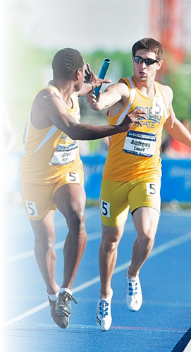
Situations: Two-Year College Transfer
Graduated from the two-year college
High school qualifier; completed only one term
Attended for more than one term, but did not graduate
Notes:
Explain that the requirements for two-year college transfers vary, depending on the transfer circumstances. Knowing the rules helps us make their transition to Division II go smoothly.
Review the situations on the slide.
Transition: “Let’s look at each of these situations more closely.”
Two-Year College Transfer Requirements
5 Slides (1 of 5)
Section time: 15 minutes

Slide 5
Two-Year College Transfer: Graduated
Attended full time for 2 semesters (or 3 quarters)
25% of credits applied toward degree earned at the two-year institution
AND
Notes:
Explain that the first situation is student-athletes who graduated from the 2-year college. Those student-athletes are eligible for Division II athletics if:
They attended that two-year college as a full-time student for at least 2 semesters (or 3 quarters), and;
At least 25% of the credits applied towards their degree requirements were earned at that two-year college.
Note: remember the PTD requirement of having earned 9 credit hours their last term of full-time enrollment also applies.
Two-Year College Transfer Requirements
5 Slides (2 of 5)
Section time: 15 minutes

Slide 6
Two-Year College Transfer: High School Qualifier/Attended One Term
Earned at least 12 transferable credit hours acceptable to a degree program at this institution
2.2 GPA for the term
Notes:
Tell the group that the second main group are student-athletes who were academic qualifiers upon finishing high school, and attended a 2-year college for only one term.
Explain that these student-athletes are eligible for Division II athletics if:
They earned at least 12 transferable credit hours acceptable to any degree program at your institution, and;
Their GPA was at least 2.2 for that one term.
Note: remember the PTD requirement of having earned 9 credit hours their last term of full-time enrollment also applies.
Two-Year College Transfer Requirements
5 Slides (3 of 5)
Section time: 15 minutes

Slide 7
Two-Year College Transfer: Attended More Than One Term/Did Not Graduate
Cumulative 2.2 GPA
Attended full time at least 2 semesters (or 3 quarters)
Earned at least 12 transferable credit hours acceptable to a degree program at this institution each term
Notes:
Explain that for student-athletes who attended a 2-year college for more than one term but did not graduate, there are more considerations.
Emphasize this applies to qualifiers as well.
Reinforce that these requirements exist to ensure student-athletes are set up for success on the path to graduation. The requirements are:
They must have a cumulative 2.2 GPA;
They must have attended that two-year college as a full-time student for at least 2 semesters (or 3 quarters);
They must have earned at least 12 credit hours acceptable to any degree program at your institution during each of those terms.
Note: remember the PTD requirement of having earned 9 credit hours their last term of full-time enrollment also applies.
Transition: “Now let’s take a look at the specific transferable credit hour requirements.”
Two-Year College Transfer Requirements
5 Slides (4 of 5)
Section time: 15 minutes

Slide 8
Two-Year College Transfer: Attended More Than One Term/Did Not Graduate
Only 2 activity credits count toward cumulative GPA and the credit-hour requirement
PHYSICAL EDUCATION
6 semester hours
(8 quarter hours)
ENGLISH
3 semester hours
(4 quarter hours)
MATH
3 semester hours
(4 quarter hours)
SCIENCE
Notes:
Explain that student-athletes in this situation must be able to transfer the following credit hours:
6 semester hours (or 8 quarter hours) in English,
3 semester hours (or 4 quarter hours) in Math, and
3 semester hours (or 4 quarter hours) in natural or physical science.
Click to reveal the PE information.
Note that in this situation, student-athletes can only count 2 physical education activity credits toward the cumulative GPA and the credit-hour requirement (with the exception of physical education majors).
Ask the group what questions they have.
Two-Year College Transfer Requirements
5 Slides (5 of 5)
Section time: 15 minutes

Slide 9
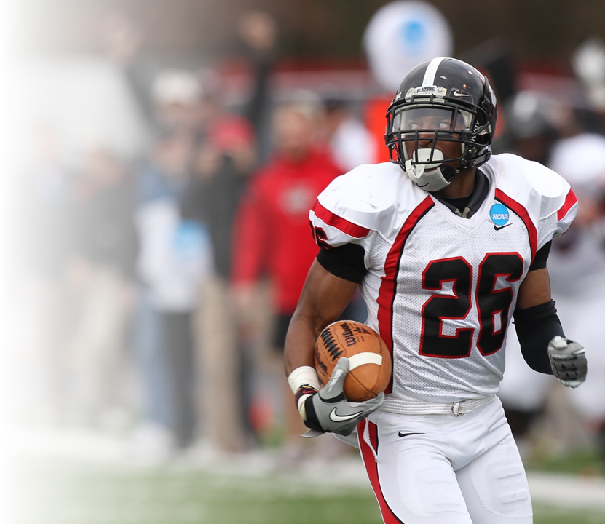
Thank you!
Final
questions?
Notes:
Ask the audience what final questions they have.
Thank them for participating, and for helping student-athletes achieve their dream of graduation!
Conclusion
1 Slide
Section time: 5 minutes

