Slide 1
About this template:
Purpose
This presentation is intended to inform student-athletes on the new Path to Graduation requirements.
Use this presentation when sharing the requirements with groups of student-athletes, or in one-on-one situations as appropriate.
The primary focus of this presentation is Progress Toward Degree. Content on two-year college transfer requirements is located at the end of the presentation.
Customization
This presentation includes the NCAA Division II Path to Graduation requirements, and is branded with NCAA logos and color schemes. Customize the content and images as appropriate for your institution.
Notes in blue within the facilitator direction indicate specific places you may want to add institution-specific information (e.g., Good Academic Standing, etc.).
Using this slide deck
Content on each slide is intended to reinforce the must-have key points (it’s not a script).
Specific facilitator notes are located in the Notes Page View of this document. View and/or print the Notes Page View of this file to see all the relevant content.
Notes:
See slide for information on using this template.
About this template
1 slide

Slide 2
Path to Graduation Requirements
<Insert Date Here>
Notes:
Welcome student-athletes to the session.
Lead the group in introductions (if desired).
<INSERT INSTITUTION-SPECIFIC INTRODUCTORY INFORMATION HERE>
Briefly share the purpose of the session: to review the Path to Graduation requirements and answer any questions about how the requirements affect student-athletes.
Transition: “Let’s start by taking a look at the progress-toward-degree (PTD) requirements.”
Introduction
2 Slides (1 of 2)
Section time: 5 minutes

Slide 3
What’s the goal?
GRADUATION!
Notes:
Remind the group that these requirements are intended to help student-athletes stay on a path to graduation, and to support them in completing their degrees.
Explain that these requirements take effect in Fall 2016. Student-athletes must meet these new requirements based on credits earned in the 2015-2016 academic year to be eligible in the fall of 2016.
Reinforce the point above: be proactive now to make sure you’re eligible and on the path to graduation.
Transition: “Before we move into specific PTD requirements, let’s review good academic standing.”
Introduction
2 Slides (2 of 2)
Section time: 5 minutes

Slide 4
Requirement: Good Academic Standing
Defined by your school
Eligibility depends on it – even if other PTD requirements are met
?
How does our school define good academic standing?
Notes:
Explain the first main eligibility requirement, which is that student-athletes must be in good academic standing.
Remind them that good academic standing is defined by your institution.
Click to reveal the question.
Ask the group how your school defines good academic standing.
<INSERT YOUR INSTITUTION AND/OR CONFERENCE’S DEFINITION HERE>
Tell the group that eligibility depends on good academic standing, even if PTD requirements are met.
Reinforce that the NCAA does not define good academic standing for institutions.
Transition: “Let’s move on to examine the other PTD requirements one at a time.”
Academic Requirements
6 Slides (1 of 6)
15 minutes

Slide 5
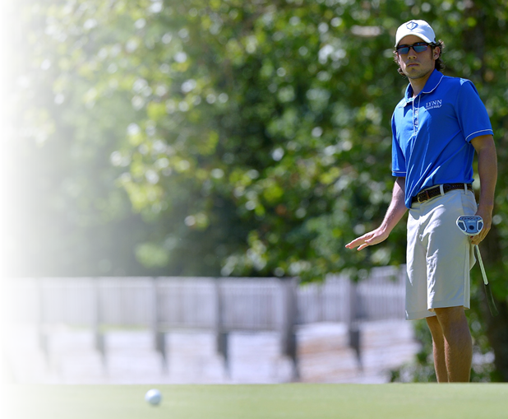
Minimum Requirements: By the Numbers
earn at least 9
SEMESTER
Notes:
Explain that student-athletes must meet several requirements related to credit hours to stay on course.
Remind the group that student-athletes must be registered as full-time students with a minimum of 12 credit hours per term.
Click to reveal the first requirement.
Explain that student-athletes are required to earn at least 9 credit hours in their last term of full-time enrollment to maintain eligibility.
Lead a brief discussion about the potential challenges of this requirement. (What do you struggle with? How can you select coursework that helps you meet the requirements and stay on the path to graduation?)
Reinforce that only the previous full-time term determines whether this requirement is met. In the Fall term, you look at the student-athlete’s previous Spring semester (if enrolled full-time), and vice-versa.
Emphasize that you cannot make this requirement up in the summer (or between terms).
Transition: “The next requirement does take into account the whole academic year.”
Academic Requirements
6 Slides (2 of 6)
15 minutes

Slide 6
Minimum Requirements: By the Numbers
earn at least 9
SEMESTER
earn at least 18
ACADEMIC YEAR
Notes:
Explain that student-athletes must earn at least 18 credit hours during the regular academic year (from the first day of classes in the Fall to Spring commencement).
Emphasize that student-athletes who do not meet this requirement in the fall can regain eligibility by earning at least 18 credit hours during the institution’s last two terms (e.g., Spring 2016 – Fall 2016).
Show the link between the last requirement and this one.
If you earn 9 credit hours each semester, you will meet this requirement as well.
Ask the group whether mini-term credits may be used.
They can, provided that they fall within the academic year (before graduation).
<INSERT INFORMATION HERE ABOUT YOUR INSTITUTION’S MINI-TERMS HERE, AND WHETHER THEY COUNT TOWARD THE REQUIREMENT.>
Reinforce that summer classes do not count towards this requirement.
Check for questions from the group.
Transition: “Summer classes can count toward our next requirement.”
Academic Requirements
6 Slides (3 of 6)
15 minutes

Slide 7
Minimum Requirements: By the Numbers
earn at least 9
SEMESTER
earn at least 18
ACADEMIC YEAR
earn at least 24
FULL YEAR
Notes:
Explain that student-athletes must earn at least 24 credit hours during any year in which they are enrolled full-time.
Tell the group that summer hours can be used to meet this requirement.
Explain that this requirement is calculated starting in the Fall term.
Note that there is a cumulative option that can be applied at the end of the second year. For student-athletes to take advantage of the 48-hour cumulative method, they must complete more than 24 credit hours their first year.
As an example, if Joe earns 27 credits his first year and 21 in his second year, he has met the requirement by earning 48 credits in the first two years, even though he did not earn 24 credits in year 2.
Transition: “We’re almost there! We know how many credit hours are needed, so let’s take a quick look at how you need to perform in those classes.”
Academic Requirements
6 Slides (4 of 6)
15 minutes

Slide 8
Minimum Requirements: By the Numbers
earn at least 9
SEMESTER
earn at least 18
ACADEMIC YEAR
earn at least 24
FULL YEAR
cumulative2.0
ANNUAL
Notes:
Tell the group that you must have a 2.0 cumulative GPA to maintain eligibility.
Ask the group how this is calculated.
Tell the group that this is calculated based on the same method used for calculating GPA for all students.
<INSERT INSTITUTION’S METHOD FOR CALCULATING GPA>
Explain that this is the cumulative GPA. If you do not meet the requirement, you can be recertified the following term if your cumulative GPA is at or above 2.0 at that time.
Transition: “And now, the final piece of the puzzle.”
Academic Requirements
6 Slides (5 of 6)
15 minutes

Slide 9
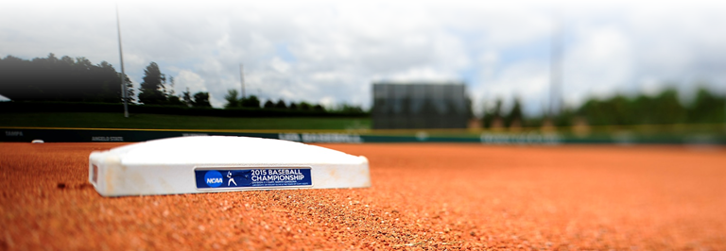
Requirement: Declaration of Degree
Declare degree by 5th semester
Starting with 5th semester, all credits used to meet PTD requirements must apply to the declared degree
!
Document the degree; verbal declarations do not count!
Notes:
Note that student-athletes need to have all the bases covered to stay on the path to graduation. Declaring a degree is a critical part of the journey.
Explain that you must declare a degree by the beginning of your 5th semester (typically your 3rd year).
Tell the group from the 5th semester onward, credits must apply to the degree to meet the other requirements:
9 credit hours per semester;
18 credit hours per academic year;
24 credit hours per year.
Click to reveal the verbal declarations note.
Remind the group that the degree declaration must be documented.
Verbal declarations do not count!
Reinforce that you should think about your degree decision in advance and talk with your advisor about it as early as possible – not just when you get to your third year. Eligibility is important, but your career goals after college are even more important!
Transition: “Remember, this is all about staying on track for your degree.”
Academic Requirements
6 Slides (6 of 6)
15 minutes

Slide 10
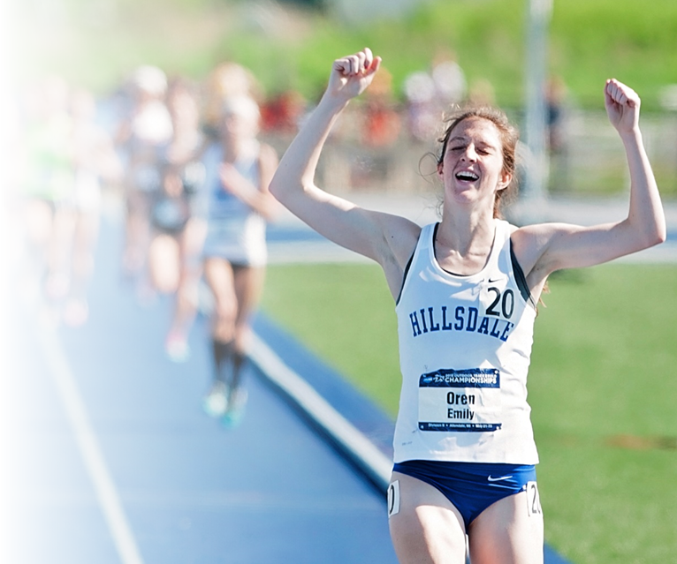
Why it matters
12 hours/term = degree in 5-6 years
15 hours/term = degree in 4-5 years
Notes:
Reinforce the importance of crossing the finish line (graduation).
Tell the group that progress toward a degree is only getting more important as educational costs continue to increase. Staying on track to complete school on time makes it more likely you will graduate.
Click to reveal the examples.
Remind them that the financial benefits of graduating in 4 years compared to 5 or 6 can be enormous. As an example, for a 126-hour degree:
12 credit hours per term will get student-athletes to a degree in 5-6 years.
15 credit hours per term will get student-athletes to a degree in 4-5 years.
Rationale & Resources
2 Slides (1 of 2)
Section time: 10 minutes

Slide 11
NCAA Division II: Make Graduation Yours
TOOLKIT
Notes:
Explain that the NCAA has provided a toolkit of resources to help educate student-athletes, advisors, administrators and others on the requirements. It includes (but is not limited to):
A video webisode series introducing the requirements.
Practice scenarios based on the most common PTD situations.
Checklists to help you keep track of coursework.
One-page guides with the basic requirements.
Show the group how to access the toolkit from the NCAA website.
Explain how the toolkit works:
You may see tweets with links to specific content on the toolkit that can help remind you of requirements as situations come up.
You can check resources on the toolkit at any time if you have questions about particular requirements.
Rationale & Resources
2 Slides (2 of 2)
Section time: 10 minutes

Slide 12
Check Your Knowledge
Navigate to the scenarios.
Complete the assigned scenarios.
Ask questions.
Notes:
<SELECT 4-5 SCENARIOS FROM THE TOOLKIT TO FOCUS ON FOR THIS ACTIVITY.>
Explain that student-athletes can now check their knowledge of the requirements using the scenarios in the toolkit.
Have student-athletes navigate to the scenario section on their phones/tablets/laptops.
Allow 5 minutes for student-athletes to work through the scenarios you selected.
Once time is up, allow student-athletes to ask specific questions about the scenarios.
Transition: “Let’s take one last look at the requirements.”
Review
2 Slides (1 of 2)
Section time: 10 minutes

Slide 13
Final Review
earn at least 9
SEMESTER
earn at least 18
ACADEMIC YEAR
earn at least 24
FULL YEAR
cumulative2.0
ANNUAL
Notes:
Review the requirements one last time.
Review
2 Slides (2 of 2)
Section time: 10 minutes

Slide 14
Thank you!
Final
questions?
Notes:
Ask student-athletes what final questions they have.
Thank them for participating, and for staying on the path to graduation!
Conclusion
1 Slide
Section time: 5 minutes

Slide 15
Two-Year College transfer Requirements
Additional information:
Notes:
Note to Presenter: Use the following slides if you a presenting to a student-athlete audience that includes two-year college transfers. Integrated into the previous slides, or use these as a stand-alone presentation as appropriate.
Divider Slide

Slide 16
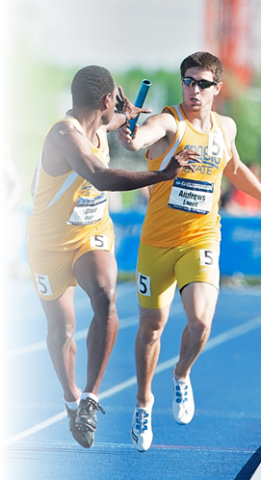
Situations: Two-Year College Transfer
Graduated from the two-year college
High school qualifier; completed only one term
Attended for more than one term, but did not graduate
Notes:
Explain that the requirements for two-year college transfers vary, depending on the transfer circumstances. Knowing the rules helps make the transition to Division II go smoothly.
Review the situations on the slide.
Transition: “Let’s look at each of these situations more closely.”
Two-Year College Transfer Requirements
5 Slides (1 of 5)
Section time: 15 minutes

Slide 17
Two-Year College Transfer: Graduated
Attended full time for 2 semesters (or 3 quarters)
25% of credits applied toward degree earned at the two-year institution
AND
Notes:
Explain that the first situation is student-athletes who graduated from the 2-year college. Those student-athletes are eligible to participate in Division II athletics if:
They attended that two-year college as a full-time student for at least 2 semesters (or 3 quarters), and;
At least 25% of the credits applied towards their degree requirements were earned at that two-year college.
Note: remember the PTD requirement of having earned 9 credit hours their last term of full-time enrollment also applies.
Two-Year College Transfer Requirements
5 Slides (2 of 5)
Section time: 15 minutes

Slide 18
Two-Year College Transfer: High School Qualifier/Attended One Term
Earned at least 12 transferable credit hours acceptable to a degree program at this institution
2.2 GPA for the term
Notes:
Tell the group that the second main group are student-athletes who were academic qualifiers upon finishing high school, and attended a 2-year college for only one term.
Explain that these student-athletes are eligible for Division II athletics if:
They earned at least 12 transferable credit hours acceptable to any degree program at your institution, and;
Their GPA was at least 2.2 for that one term.
Note: remember the PTD requirement of having earned 9 credit hours their last term of full-time enrollment also applies.
Two-Year College Transfer Requirements
5 Slides (3 of 5)
Section time: 15 minutes

Slide 19
Two-Year College Transfer: Attended More Than One Term/Did Not Graduate
Cumulative 2.2 GPA
Attended full time at least 2 semesters (or 3 quarters)
Earned at least 12 transferable credit hours acceptable to a degree program at this institution each term
Notes:
Explain that for student-athletes who attended a 2-year college for more than one term but did not graduate from the 2-year college, there are more considerations.
Emphasize this applies to qualifiers as well.
Reinforce that these requirements exist to ensure student-athletes are set up for success on the path to graduation. The requirements are:
They must have a cumulative 2.2 GPA;
They must have attended that two-year college as a full-time student for at least 2 semesters (or 3 quarters);
They must have earned at least 12 credit hours acceptable to any degree program at your institution during each of those terms.
Note: remember the PTD requirement of having earned 9 credit hours their last term of full-time enrollment also applies.
Transition: “Now let’s take a look at the specific transferable credit hour requirements.”
Two-Year College Transfer Requirements
5 Slides (4 of 5)
Section time: 15 minutes

Slide 20
Two-Year College Transfer: Attended More Than One Term/Did Not Graduate
Only 2 activity credits count toward cumulative GPA and the credit-hour requirement
PHYSICAL EDUCATION
6 semester hours
(8 quarter hours)
ENGLISH
3 semester hours
(4 quarter hours)
MATH
3 semester hours
(4 quarter hours)
SCIENCE
Notes:
Explain that student-athletes in this situation must be able to transfer the following credit hours:
6 semester hours (or 8 quarter hours) in English,
3 semester hours (or 4 quarter hours) in Math, and
3 semester hours (or 4 quarter hours) in natural or physical science.
Click to reveal the PE information.
Note that in this situation, student-athletes can only count 2 physical education activity credits toward the cumulative GPA (with the exception of physical education majors).
Ask the group what questions they have.
Two-Year College Transfer Requirements
5 Slides (5 of 5)
Section time: 15 minutes

